Slide 1

BREEZE
PGKPI - 2021

Slide 2
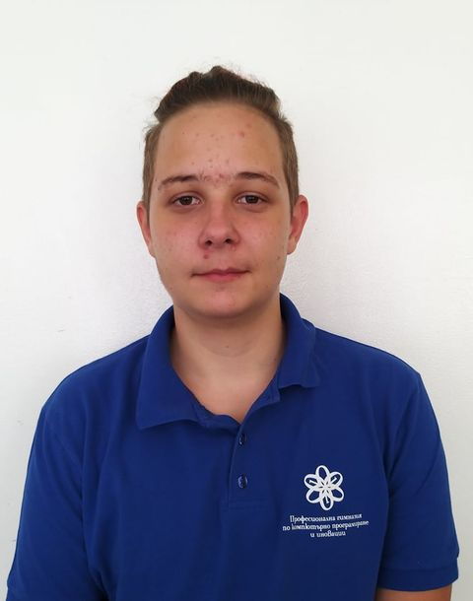
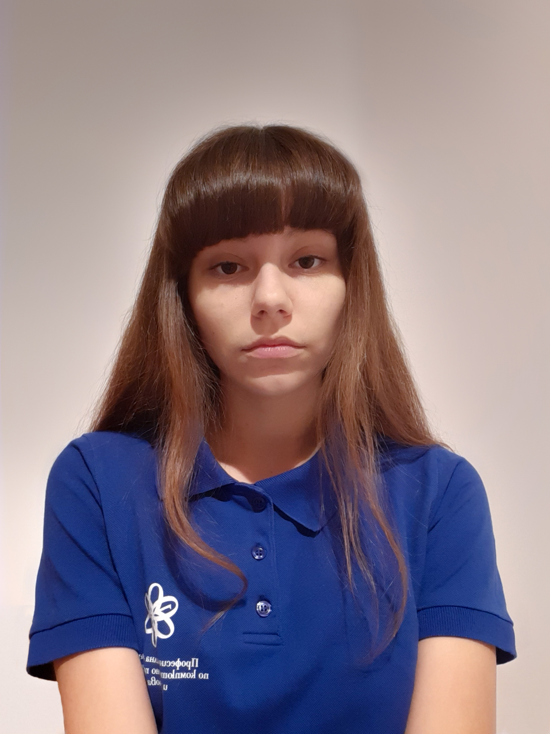
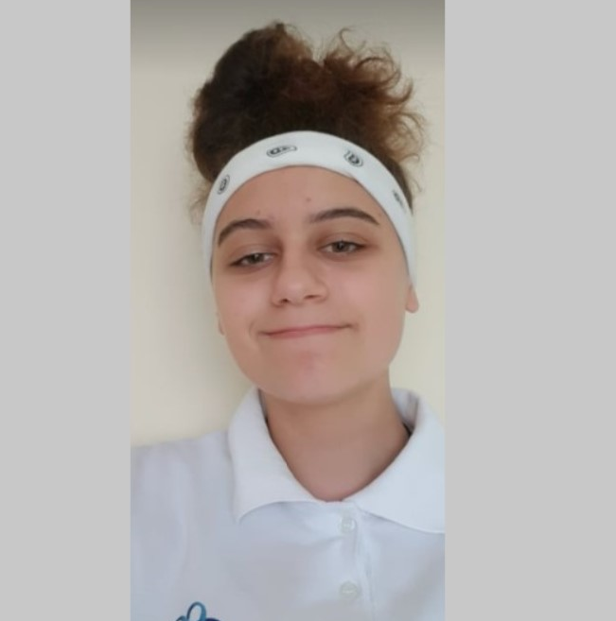
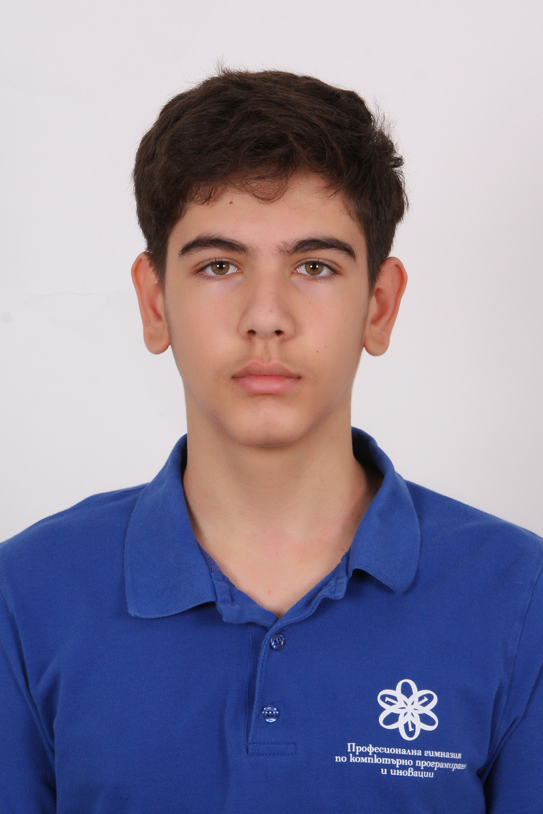
TEAM
M
M
M
I
Maksimiliyan Dimov
Mariya Ilcheva
Mirena Dzhebarova
Ivaylo Radev
Scrum Trainer
Front-End Developer
Back-End Developer
Designer

Slide 3






PROJECT
112

Slide 4

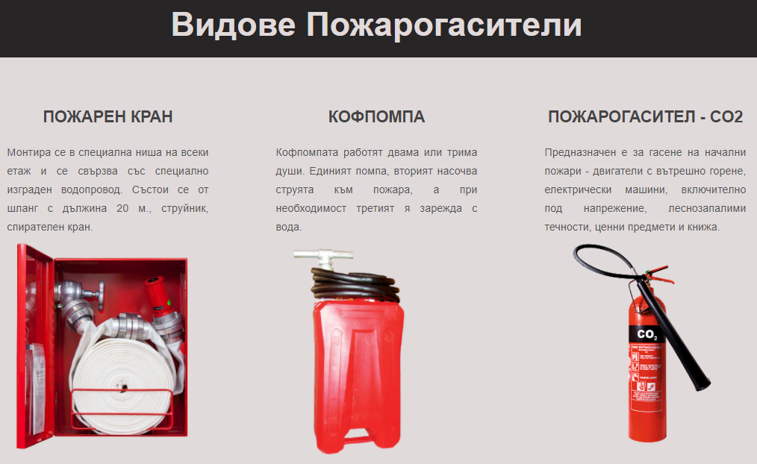
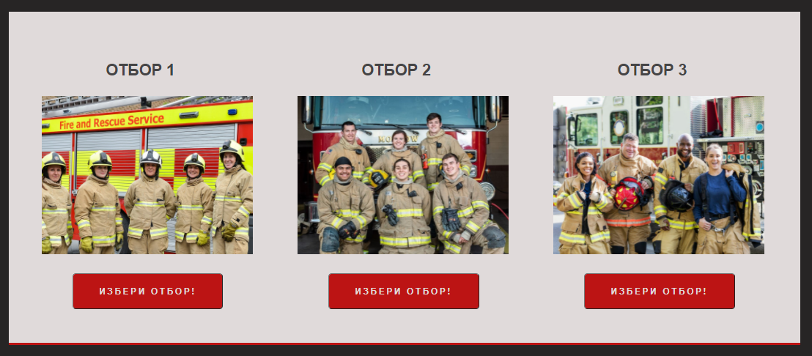
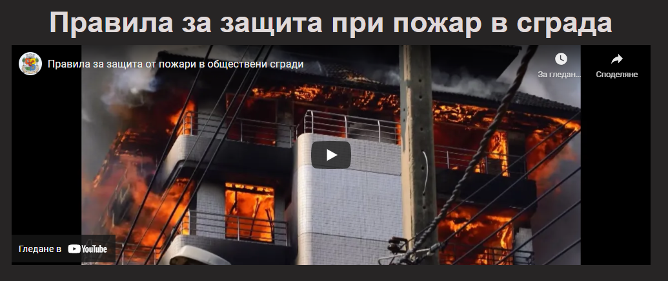
WEBSITE

Slide 5
WORK STAGES
01
02
03
05
04
IDEA
ORGANIZATION
REALIZATION
TESTING
PREZENTING

Slide 6











USED PROGRAMS AND PROGRAMMING LANGUAGES

Slide 7





FUTURE IDEAS

Slide 8
THANKS FOR YOUR ATTENTION!

